Slide 1
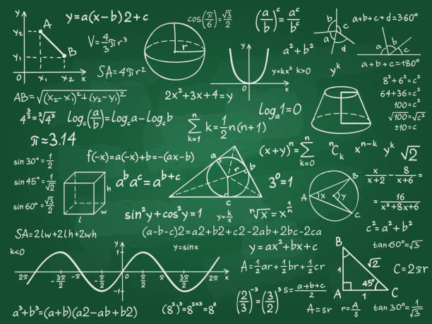
Welcome To College Algebra
Review the syllabus (short version) & schedule.
Note any questions you have on course, syllabus, schedule, etc.

Slide 2
College Algebra CoReq
This class will be different in many ways from other math classes you may have been in. You are going to interact with each other quite a bit and talk to each other about the material being covered.
I know that some of you do not like to talk in class and that others of you like to talk a lot. So, we will be following a couple of easy rules. We give everyone a chance to talk. We respond to whatever anyone says with respect. We are concerned here about concepts that will help you learn, and I expect that students in this class will support each other in working together.
I will put you into groups, and I will expect that you will contribute to the discussion of the problems that your group is working on.

Slide 3
Syllabus & Schedule Activity
Fill out Team Worksheet
(I will be collecting this worksheet.)
2. For each person in your group
What is your Name.
What is your intended major or career? (I want to know what you "think" you might like to do.)
List a “fun fact” about yourself.
Come up with at least two questions (or comments) from the syllabus.
Fill out Team Worksheet

Slide 4
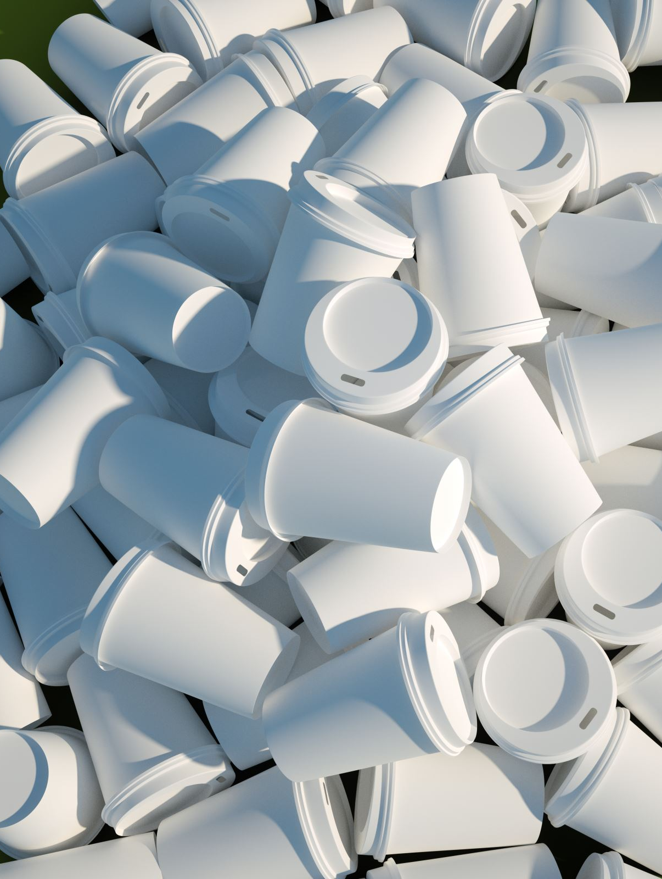
Construction Challenge
How fast can your team build a pyramid out of cups without touching the cups directly with your hands?

Slide 5
Construction Challenge
Create a tool using your kit (string/rubber band).
Rules: (when you start to build)
Each string can only be held at the very end.
You may NOT touch your partners string at anytime!
You may NOT touch your rubber band at anytime!
Your hands may NOT touch the cups anytime they are on the table
Start with 8 cups up, 8 cups down.
Pyramid layout picture in kit
If you drop your cup on the floor, you may pick it up and place it on the corner of your table to continue.
Break ANY RULE: You will have to restart!
Any Questions?

Slide 6
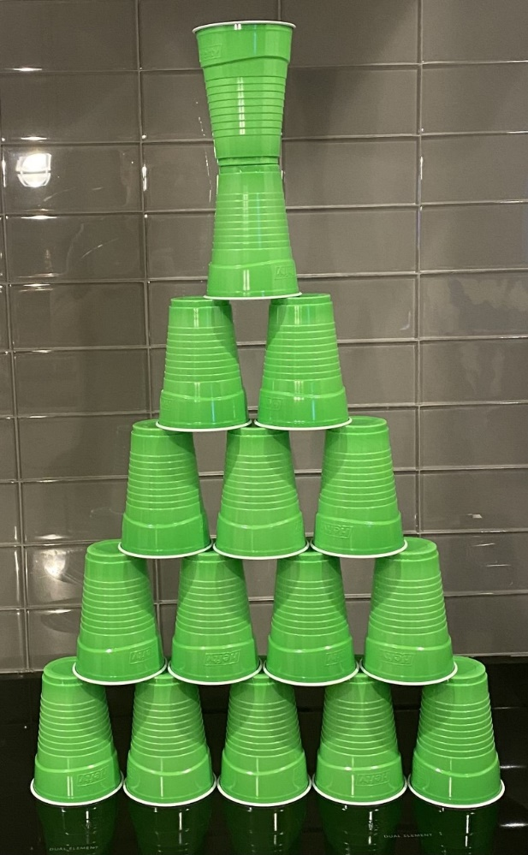
Wrap Up
What were some of the challenges your group faced during construction? How did you resolve the conflicts that came up?
What creativity and collaboration techniques did your group undertake to complete this activity successfully?
How did you support your team members through this activity?

